Slide 1
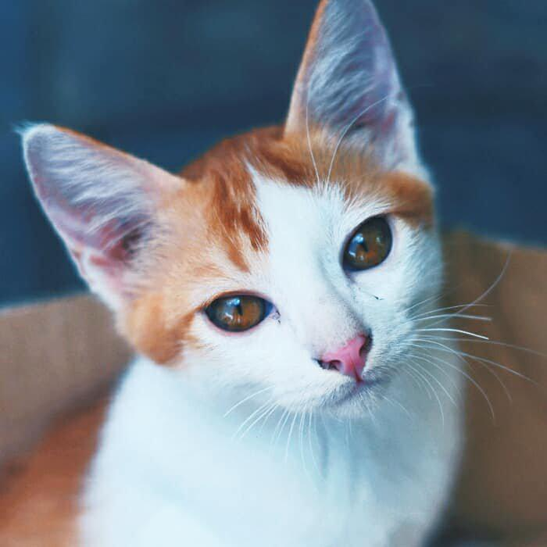
Figure 1: Pipeline
Image Feature
No Fusion
Image
Image Backbone
Fusion
Prediction Model
Output
. . .
GBDT/MLP
No Fusion
Metadata

Slide 2
Figure 2: Early Fusion
Image Feature
Image
Image Backbone
Early Fusion
Prediction Model
Output
. . .
MLP
Metadata

Slide 3
Figure 3: Late Fusion
Image Feature
Prediction Model
Image
Image Backbone
Late Fusion
Output
. . .
GBDT
Metadata

